Slide 1
Web Forum Crawler
Presented by
Mohan Reddy Kanthi

Slide 2
Agenda
Introduction
Research Motivation
Objective
FoCUS
Theoretical Concepts
Implementation
Challenges
Limitations
Conclusion
Future Work
References

Slide 3
Introduction
What is a Web Forum?
What is a Forum Software Package?
Importance of Web Crawlers

Slide 4
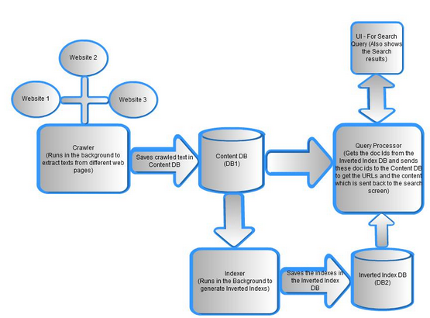

Slide 5
Research Motivation
A simple Indexer and search application created on large set of predefined web documents in ISR course
The research paper FoCUS: Learning to Crawl Web Forums. Jingtian Jiang, Nenghai Yu† and Chin-Yew Lin‡.

Slide 6
Objective
Develop an application which can crawl a web forum and also provide the source page of a URL
Identify the crawling problem as URL type recognition problem.
Application should Optimize and enhance the process used by FoCUS

Slide 7
FoCUS
It is observed that crawling problem can be changed to URL type recognition problem
Added the below features ignored by Generic crawlers
Duplicate links & uninformative pages
Page-flipping links and their relationship
Entry URL discovery
Crawling process is divided into 2 step process
Learning phase
Crawling phase

Slide 8
Theoretical Concepts
HTML DOM
Terminology
Link Structure
Observations
Index/Thread URL detection
Page Flipping URL detection
Entry URL discovery

Slide 9
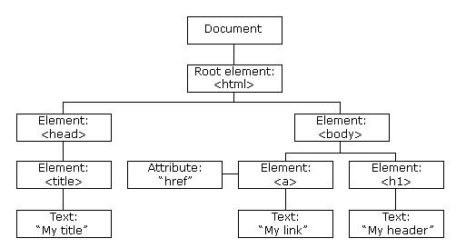
HTML DOM
The HTML DOM is a standard object model and programming interface for HTML

Slide 10
Terminology
Page Types
Entry Page
Index Page
Thread Page
URL Type
Index URL
Thread URL
Page Flipping URL
EIT Path (Entry -> Index -> Thread)

Slide 11


Slide 12
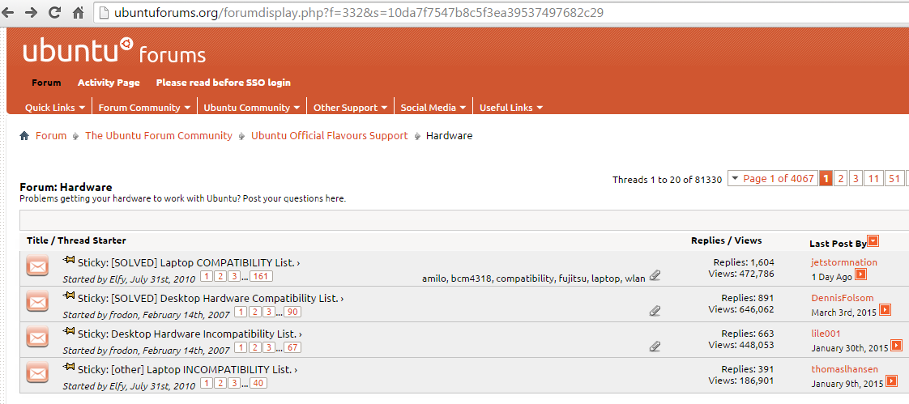

Slide 13
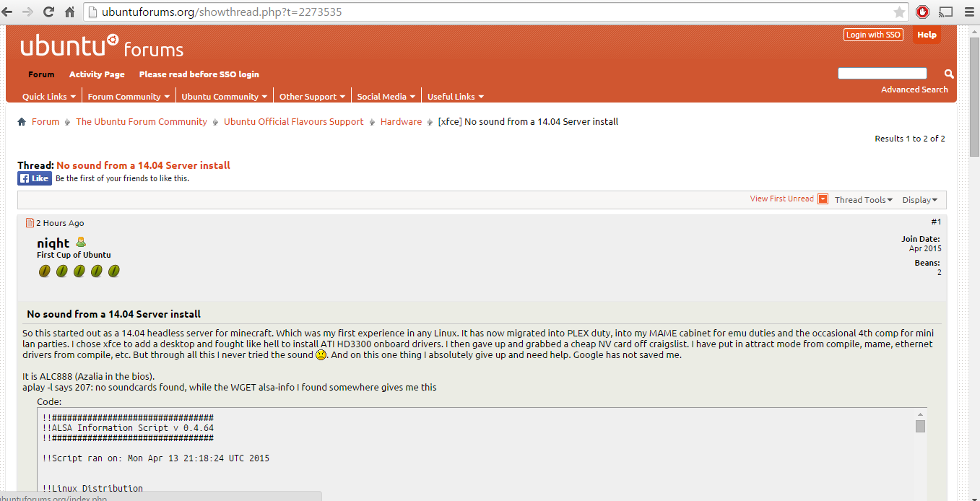

Slide 14
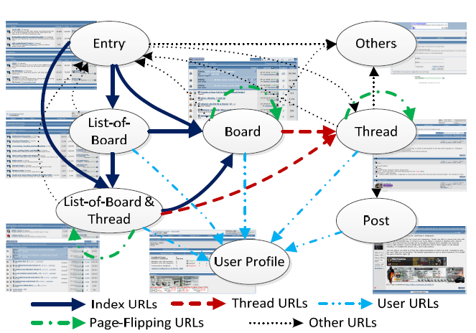
Link Structure

Slide 15
Observations
Navigation path on forum pages
URL Layout on a forum page
Page Layout of different page types on a forum

Slide 16
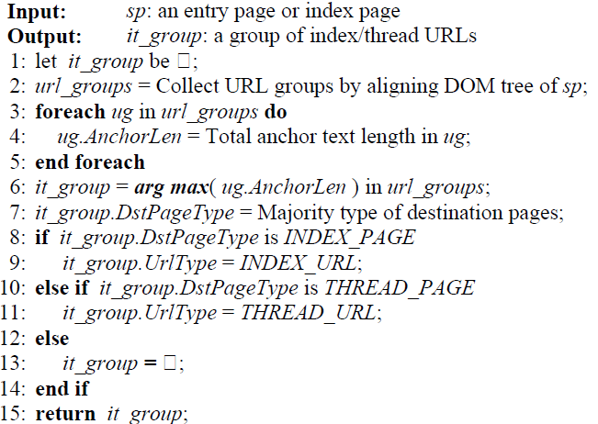
Index/Thread URL detection

Slide 17
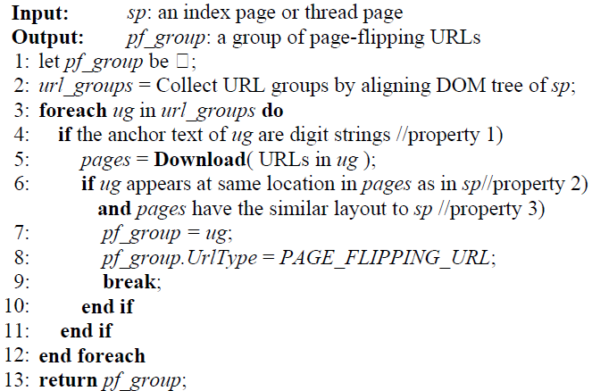
Page Flipping URL detection

Slide 18
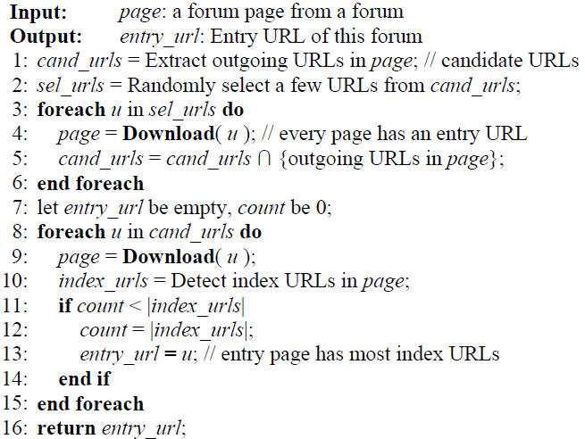
Entry URL discovery

Slide 19
Implementation
Development Environment
Block Diagram
Crawler Process
Classifiers
Screenshots

Slide 20
Development Environment
Tools
Eclipse IDE
MySQL Database
Technologies
JDK 1.7
Tomcat 7.0
Jsp
Servlets
Html
JavaScript & CSS

Slide 21
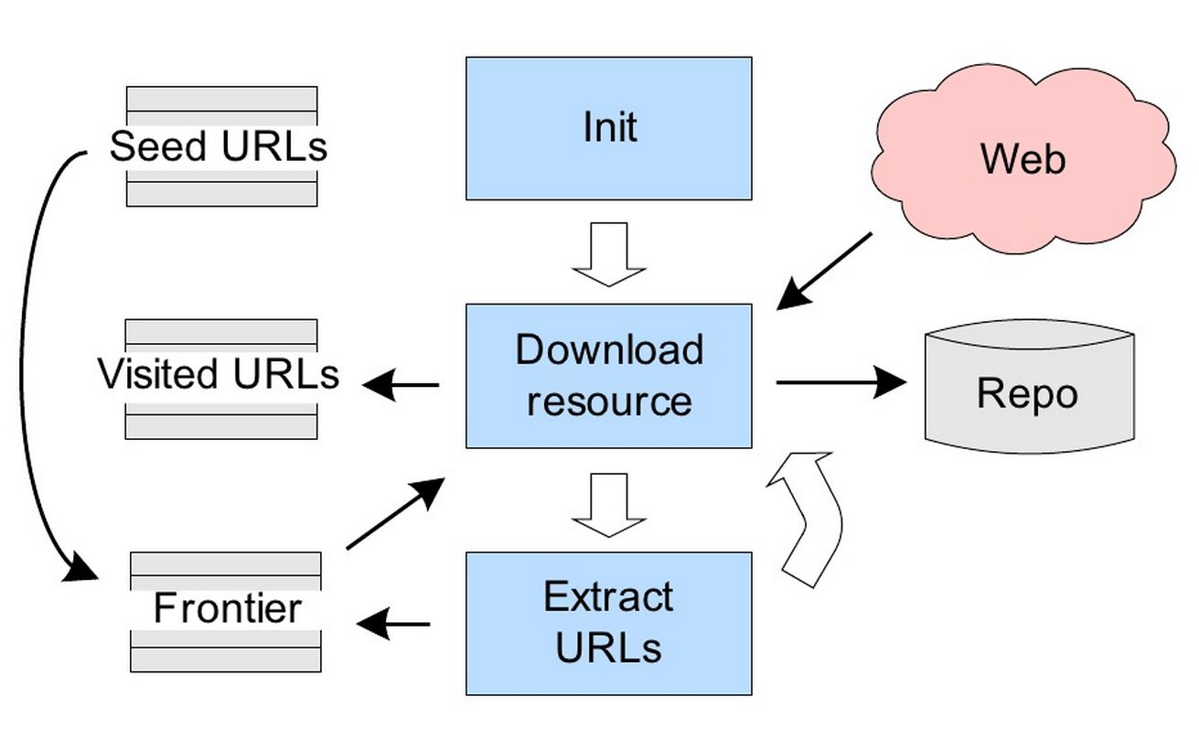
Block Diagram

Slide 22
Crawler Process
Take input forum URL from the user
Load the Classifier configurations
Find the Entry URL from the URL given using the Entry URL discovery algorithm
Add the Entry URL into the Queue
For each URL from the Queue Apply the Index/Thread URL detection and Page-Flipping algorithms to find the page type of the URL
Save the results to Repository
For each URL from the Queue get the HTML DOM
Preprocess and Validate the URL’s in the DOM object
Add the Validated URL’s to Queue and save the URL type of the parent as source page for this URL
Return the results (page types, count and Navigation path) for each URL to theuser

Slide 23
Classifiers & Forum Platforms
Forum Platform
vBulletin
Exo Platform
Discourse
Classifiers
Valid Link Count
Anchor Text Length
Plain Text Length
User Profile Link

Slide 24
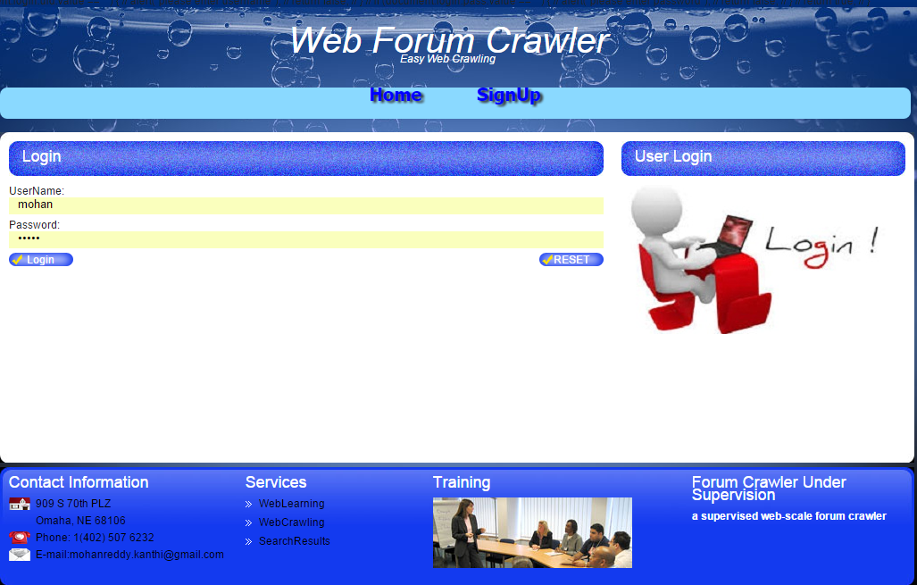
Screenshots (Login Page)

Slide 25
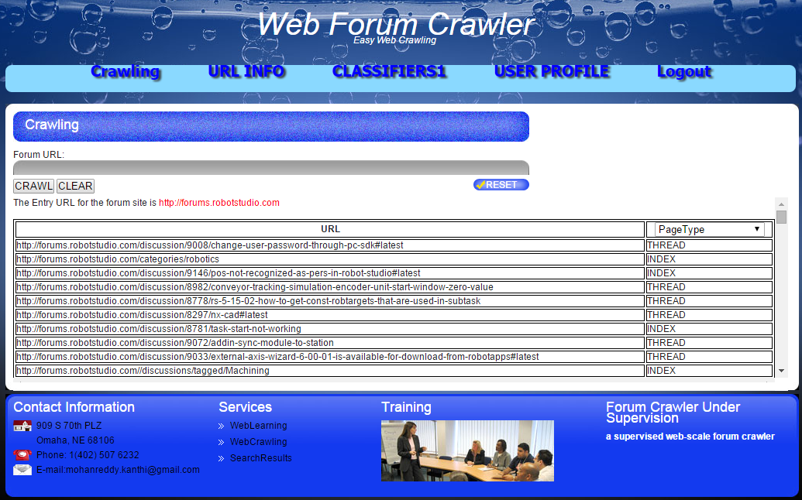
Screenshots (CrawlingPage)

Slide 26
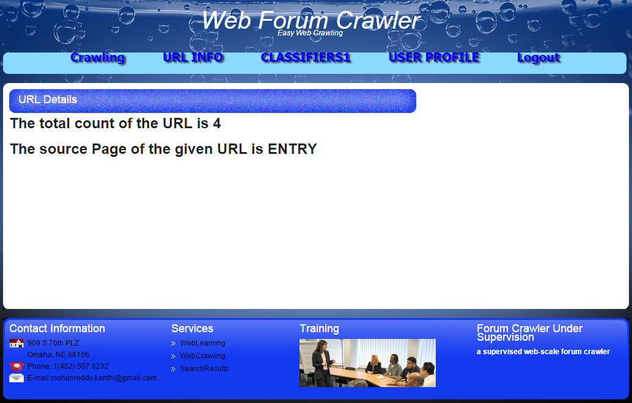
Screenshots (URL Info Page)

Slide 27
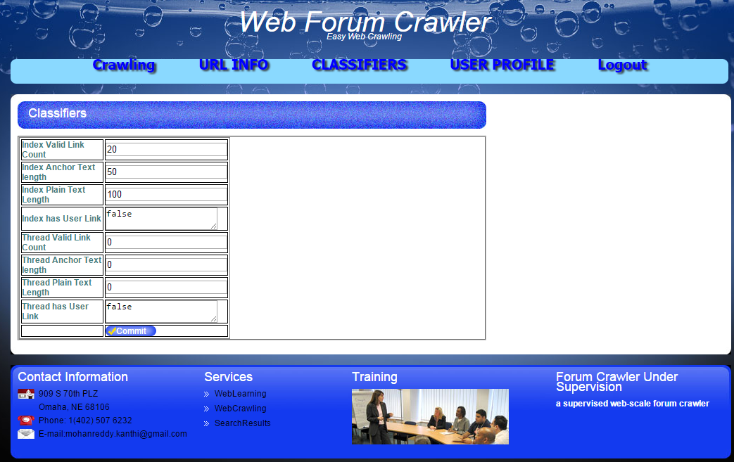
Screenshots (Classifiers Page)

Slide 28
Challenges
Web forums has large volume of data, has fast rate of change and Dynamic page generation
Crawling a forum can be challenging task due to complex in-site link structures and login controls of most forum sites
Processing time of crawling a forum site

Slide 29
Limitations
Processing time for crawling a forum site is taking more than an expected time with a general purpose computer
Limited the crawler to process the first 1000 valid URL’s on forum site
The anchor text classifier is being disabled for the URL’s with image

Slide 30
Conclusion
Reduced the forum crawling problem to URL type recognition problem
Optimized the process of learning and crawling the web forum site pages.
The page classifier process is simplified by manually preselecting software forum packages to be used with page type classifiers.
The navigational path for each of the URL’s can be retrieved using the source page

Slide 31
Future Work
The crawler can be integrated into distributed network for processing large amount of forum data in short amount of time
Structuring of Repo can be improved in order to use this in large scale web applications such as search engines
Handling the multi media anchor text for the URL’s on page for crawling.
I would like to handle forums which use JavaScript, include incremental crawling, and discover new threads and refresh crawled threads in a timely manner.
I would like to configure the crawler to be able to focus on other types of focused sites like social media, sharepoint, etc.

Slide 32
References
[1] Jingtian Jiang, Nenghai Yu† and Chin-Yew Lin‡. FoCUS: Learning to Crawl Web Forums IEEE transactions on knowledge and data engineering Vol: 25 no:6 Year 2013
[2] Rui Cai, Jliang-Ming Yang, Wei Lai, YidaWang and Lei Zhang, “iRobot: An Intelligent Crawler for Web Forums,” in Proceeding of the 17th international conference on World Wide Web (WWW 2008)
[3] Z. Bar-Yossef, I. Keidar, and U. Schonfeld. Do not crawl in the DUST: different URLs with similar text. In Proc. of 16th WWW, pages 111-120, 2007.
[4] Internet Forum Software.
http://en.wikipedia.org/wiki/category:internet_forum_
[4] M. L. A. Vidal, A. S. Silva, E. S. Moura, and J. M. B. Cavalcanti. Structure-driven crawler generation by example. In Proc. 29th SIGIR, pages 292−299, Seattle, USA, Aug. 2006

